Slide 1
Database Management Systems HTML CODE GENERATOR TOOL
By
B. Akshaya(2110030345)
U. Yesashwini(2110030412)
P. Subhatish(2110030426)
K. Dhana Sree(2110030444)
Under the guidance of
(Ms. P. Sree Lakshmi)

Slide 2
Problem statement and domain
We are creating a web application for university registration as part of our project.
Manual registration is tedious and takes a lot of time and labor.
In Online, we can access it from anywhere, doesn't require human labor or assistance from others.
By managing the data with correct authentication, we can reduce the workload of all those manually involved and lessen the effort.

Slide 3
Our Objective
To identify the challenges of the online course registration system.
To review and evaluate the online registration website.
Check whether the issues are cleared through our web application or not.

Slide 4
Existing solutions/ Naïve solutions
LMS
ERP
OFFLINE REGISTRATION

Slide 5
Additional Features In Our Web Application
Offer opportunities to provide feedback.
Add a questionnaire forum to rectify doubts regarding registration.
An instructor/mentor to respond to your doubts.

Slide 6
Proposed Algorithm Design Technique
What is the technique?
We are using HTML, DBMS, and Python language.
How is it suitable for your application?
We use DBMS to store the entered data back-end.
We use HTML and Python for front-end webpage design.
What do you know about the solution of it using the proposed design method?
The solution we have come up with is that HTML and Python helps to create dynamic webpage easily compared to other languages.
Also storing data in database is better than saving in files.

Slide 7
Tools required
My SQL
MySQL is a database management system.
MySQL is ideal for storing application data in multiple tables, specifically web application data.
TerraER
ER diagrams help to explain the logical structure of databases and relationships between entities to attributes.

Slide 8
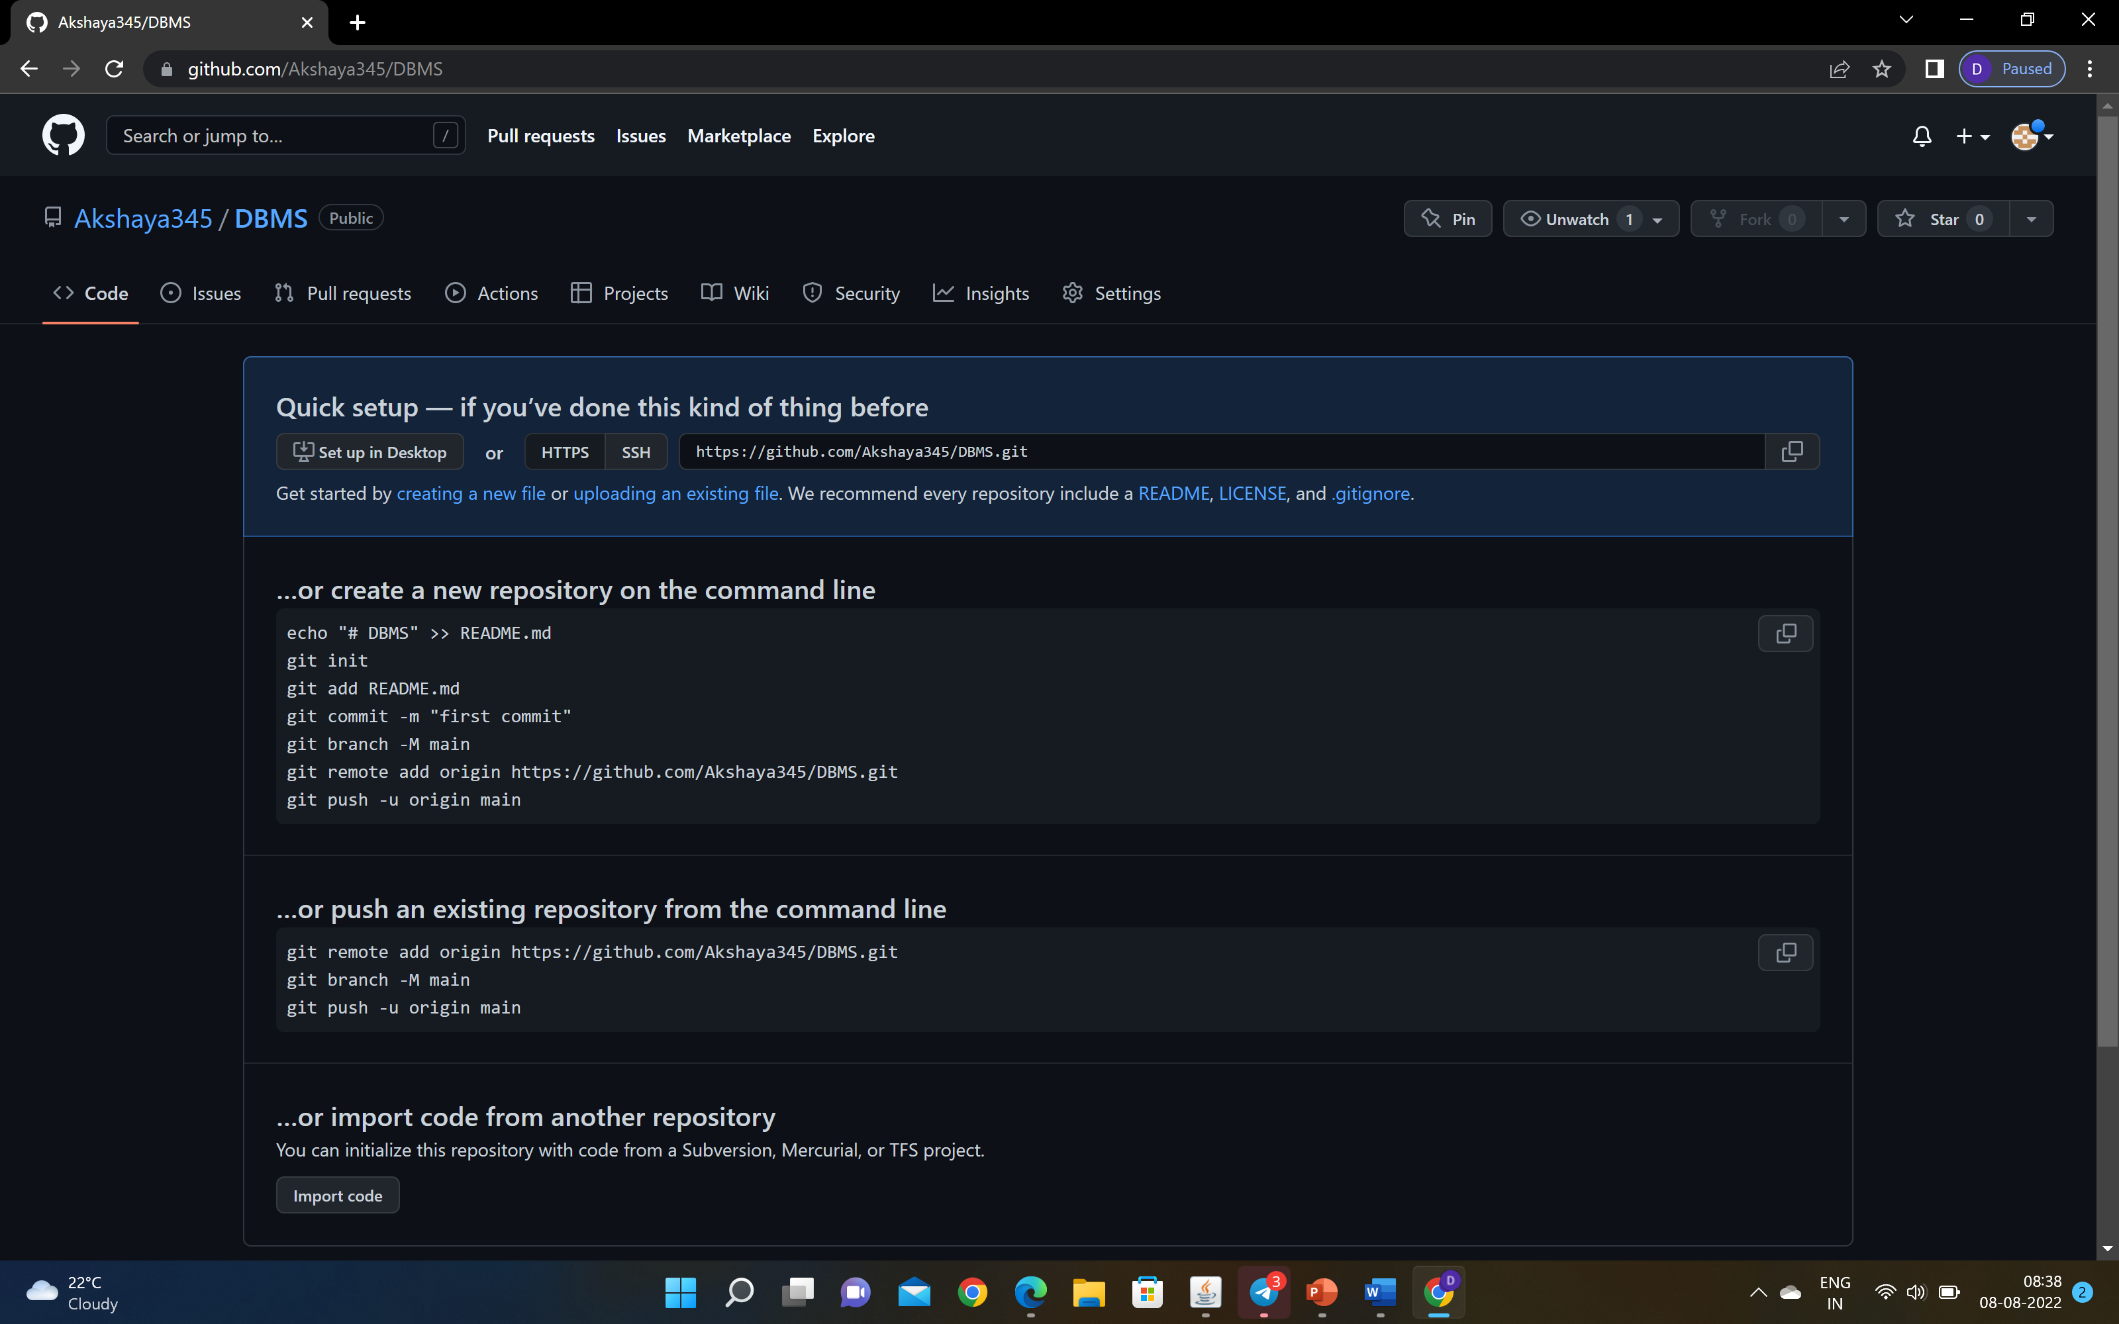
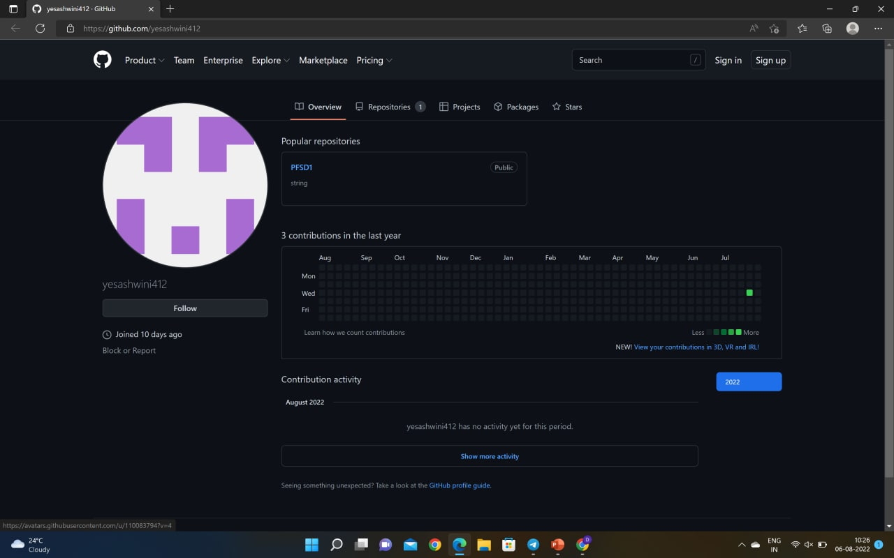
Github setup
https://github.com/Akshaya345/DBMS
https://github.com/yesashwini412

Slide 9
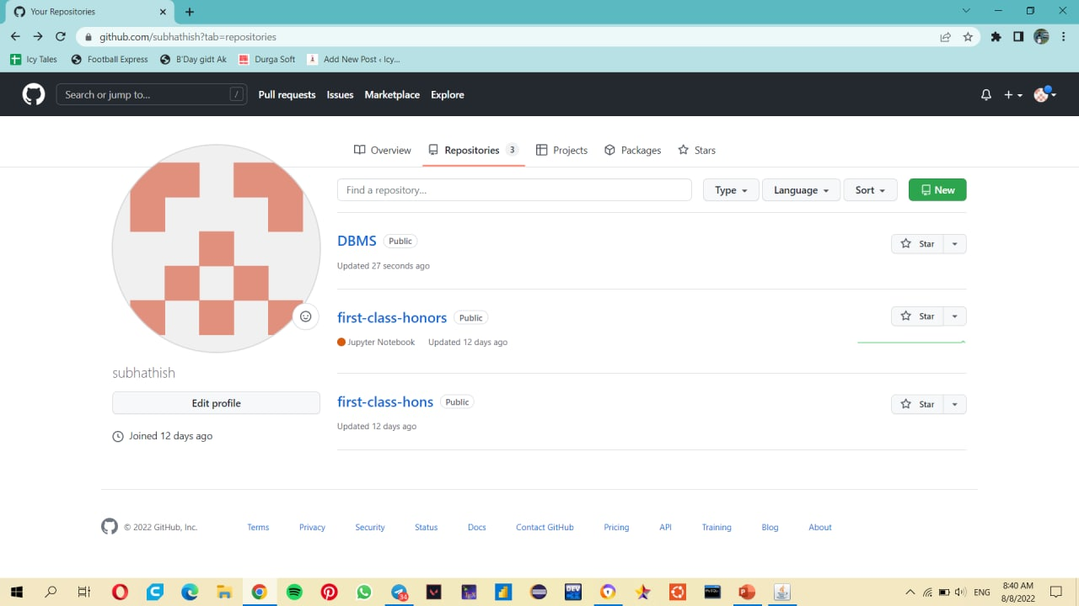
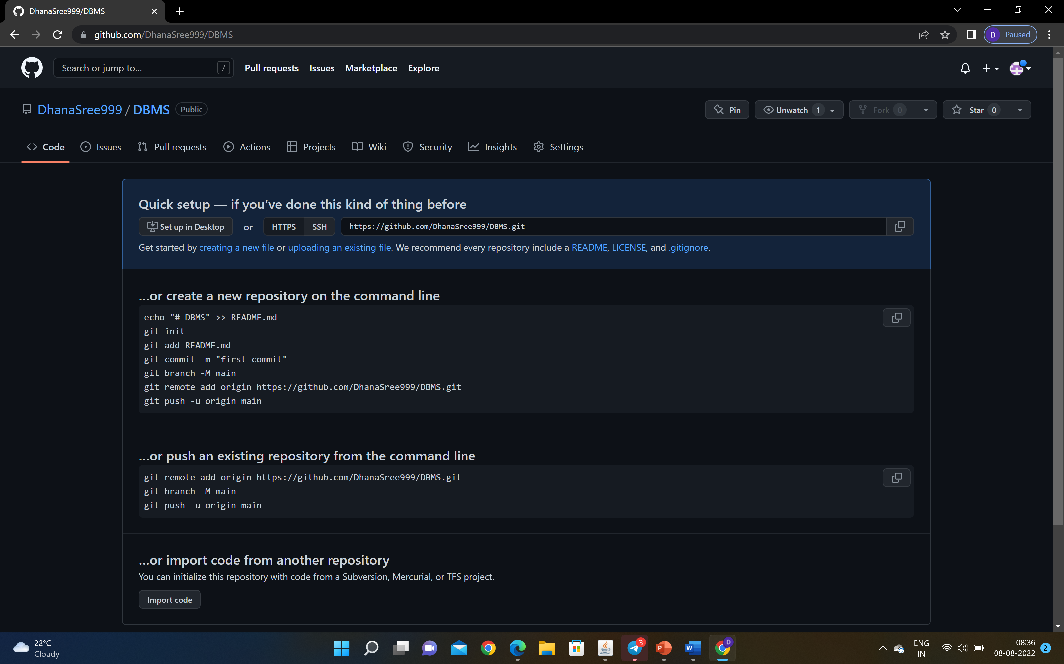
https://github.com/subhathish?tab=repositories
https://github.com/DhanaSree999/DBMS

Slide 10
Division of work among the group members
S.NO | ROLL NO | NAME | DIVISION OF WORK
1 | 2110030345 | B.AKSHAYA | Communication, planning
2 | 2110030412 | U.YESASHWINI | Software documentation, testing
3 | 2110030426 | P.SUBHATHISH | Modelling(front-end), review
4 | 2110030444 | K.DHANA SREE | Development(back-end), maintenance

